Slide 1
Our Cool Name
Most Popular
Explore More
Previous Searches
Find recipes from your favorite meals
Use your voice
Clear
Search
Results 10 Searches:
Recipe 1
Recipe 2
Recipe 1
Recipe 2
Recipe 1
Recipe 2
Recipe 1
Recipe 2
Recipe 1
Recipe 2

Slide 2
Our Cool Name
Previous Searches
Explore More
Find recipes from your favorite meals
Sdjkafklsdajfklsdajnkfldjl;ksajflkasj;dklfjcsldc sdjfakdsjakfjsd;af
Try to use a wake up command like “Alexa” “Hey Siri”
Notes:
Voice command auto search
Text command click on search
Use your voice
Clear
Search
Results 10 Searches:
Recipe 1
Recipe 2
Recipe 1
Recipe 2
Recipe 1
Recipe 2
Recipe 1
Recipe 2
Recipe 1
Recipe 2

Slide 3
Our Cool Name
Previous Searches
Explore More
Find recipes from your favorite meals
Use your voice
Clear
Search
[Title]
[Ingredients]
Results 10 Searches:
Recipe 1
Recipe 2
Recipe 1
Recipe 2
Recipe 1
Recipe 2
Recipe 1
Recipe 2
Recipe 1
Recipe 2
Back to results
See More

Slide 4
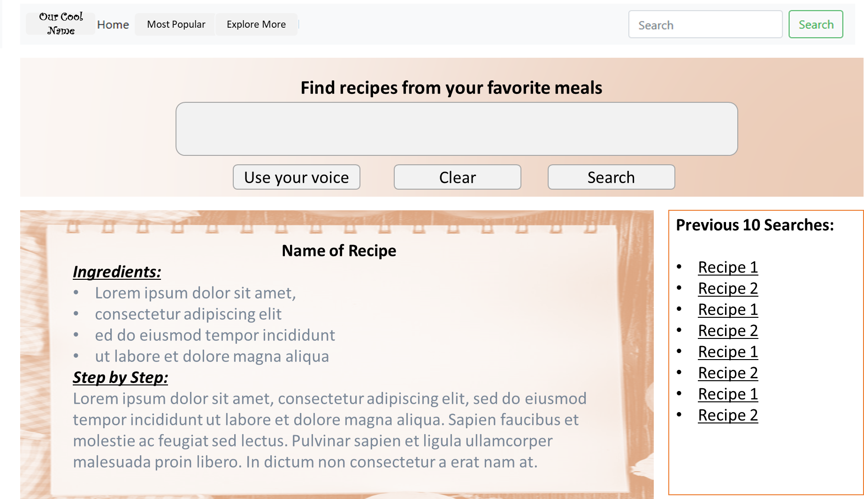
Our Cool Name
Previous Searches
Explore More
Find recipes from your favorite meals
Use your voice
Clear
Search
Back to Results

Slide 5
Previous Searches
Explore More

Slide 6
Previous Searches
Explore More

